Slide 1

MINI PROJECT 2 : CLASSIFICATION Business Goal : Model to determine the Grade of house
MAITRI NARANG DSFT 8

Slide 2
About Data :
The data contains 3000 records with no null values.
The data is symmetrical, negligible skewness exists.

Slide 3
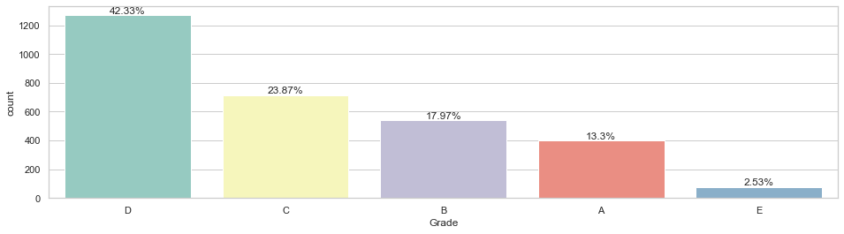
Distribution of house Grades: Here, we can see that almost half of the houses are Grade D.

Slide 4
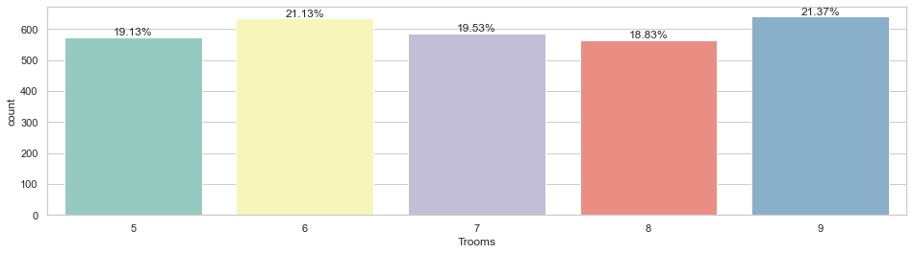
Total rooms are highest 9 followed by 6 in most houses.

Slide 5
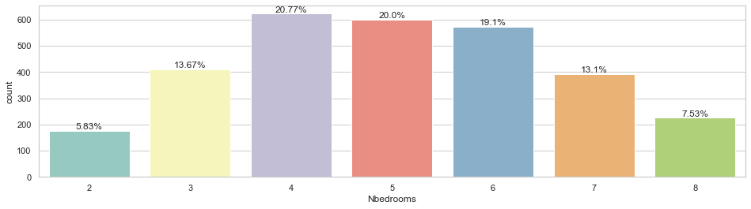
Total number of bedrooms are highest as 4 followed by 5 in most houses.

Slide 6
Total number of bedrooms are highest as 4 followed by 5 in most houses.

Slide 7
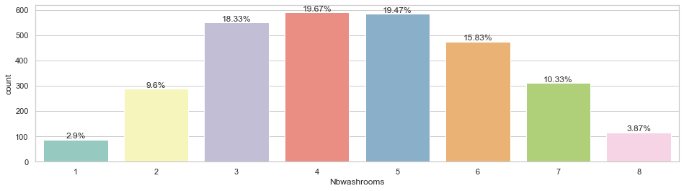
Total number of washrooms are highest as 4 followed by 5 in most houses.

Slide 8
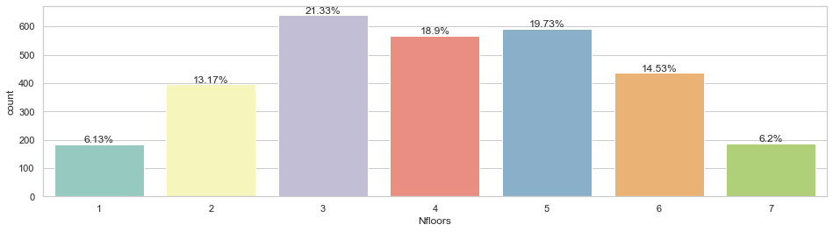
Total number of floors are highest as 3 followed by 5 in most houses

Slide 9
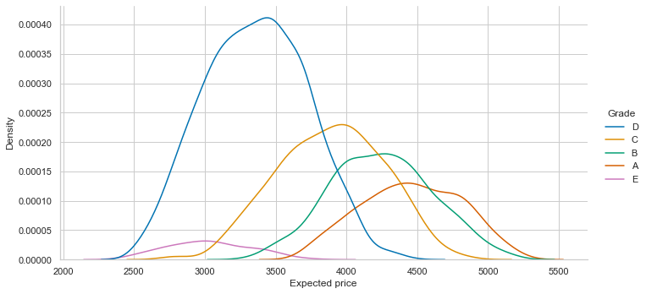
Grade E has the lowest price range and density whereas Grade B has highest.
¶

Slide 10
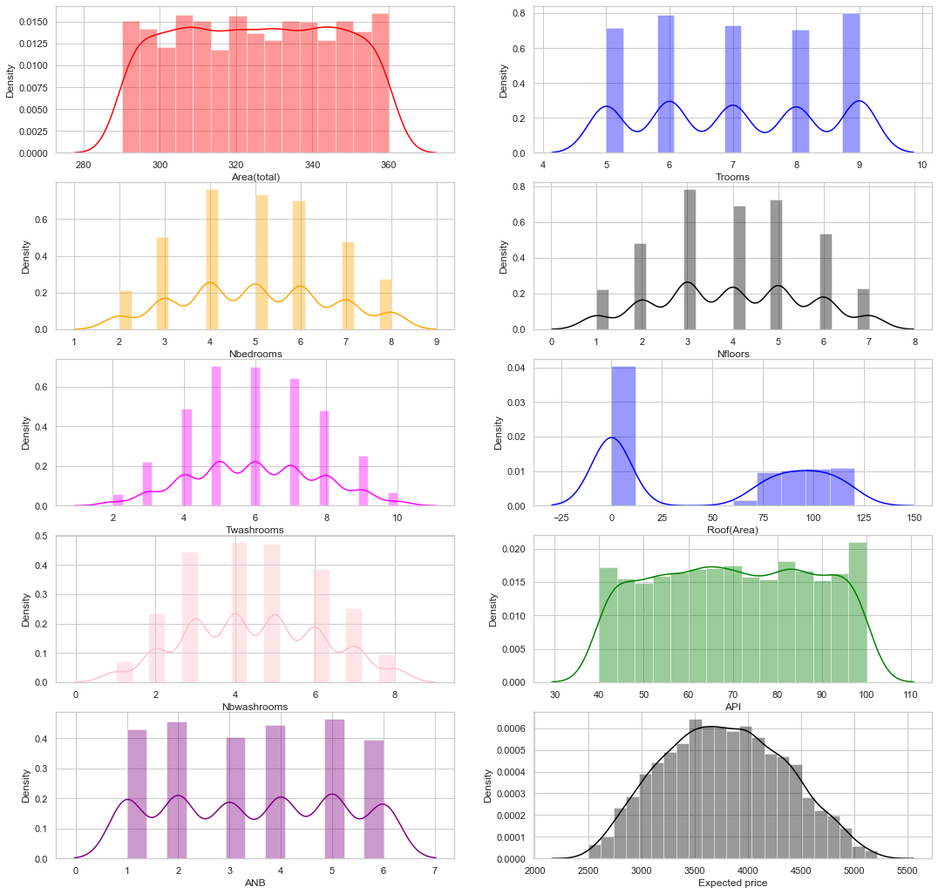
Distribution of all numeric features

Slide 11
CONCLUSIONS:
Grade D has highest count of about 42.3%.
Most houses have total 9 rooms, 4 bedrooms,4 washrooms and 3 floors.
Grade E has the lowest price range and density whereas Grade B has highest.
Price increases as total number of rooms increase wrt area.
Grade D and E have lowest prices whereas A and B have highest.
There is very minute difference in prices of houses with and without roof.
Price increases with increase in number of floors and highest at 7 floors.

Slide 12
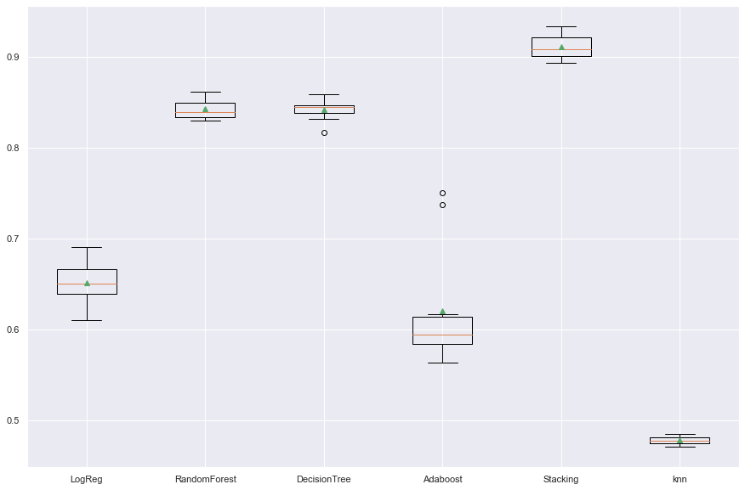
The finalized model to predict the grade of house is STACKING which shows a performance score of 91.5% with minimum errors . STACKING MODEL is the apt choice with highest accuracy of 91.5% , same mean median, normal distribution , no skewness and outliers .
Hence, the obtained model is very powerful and accurate to predictions.

Slide 13
THANKYOU

